Slide 1
STACK
Data Structures & Algorithms
Lecture 7

Slide 2

INTRODUCTION - STACK
The stack is a very common data structure
A stack is one of the most important and useful non-primitive linear data structure
Stacks hold objects, usually all of the same type
It follows the concept of LIFO – last in first out
Stack is a linear list of items in which all additions and deletions are
restricted to one end.

Slide 3
Conceptual View of a Stack
Stack : a collection whose elements are added and removed from one end, called the top of the stack
Stack is a LIFO (last in, first out) data structure
Examples:
A stack of plates – what can we do with the elements of this collection?
Other real-world examples of stacks?
Browsers
To keep track of pages visited in a browser tab
Notes:
Can add a plate to the top, take a plate form the top, look at the top plate Can check if the stack is empty.
We do not take a plate from the middle of the pile! (usually) So, where is all the activity for a stack of plates?

Slide 4
Conceptual View of a Stack
Adding an element
New object is added as the new top element of the stack
(old) top of stack
new top
bottom of stack
bottom

Slide 5
Conceptual View of a Stack
Removing an element
Object is removed from the top of the stack
top
new top
bottom
bottom

Slide 6
STACKS VS ARRAYS
An array is a contiguous block of memory.
A stack is a first-in-last-out data structure with access only to the top of the data.
The values can be added and deleted on any side from an array.
But in stack, insertion and deletion is possible on only one side of the stack. The other side is sealed.
Eg: a[10] –array a[10] - stack

Slide 7
STACK OPERATIONS
The bottom of a stack is a sealed end. Stack may have a capacity which is a limitation on the number of elements in a stack.
The operations on stack are
Push: Places an object on the top of the stack.
Pop: Removes an object from the top of the stack.
peek: examine the element at the top of the stack
IsEmpty: Reports whether the stack is empty or not.
IsFull: Reports whether the stack exceeds limit or not.
c
b
a
a
(i)stack
(ii)push(a) (iii)push(d)-stack overflow (iv)pop()
(v)pop()-stack underflow

Slide 8
STACK IMPLEMENTATION
Stack is implemented using arrays or linked lists.
Let S be a stack, n be the capacity, x be the element to be pushed, then push and pop will be given as
Push(x) and Pop()
Here we use “top” which keeps track of the top element in the stack.
When top = = -1 , pop() operation gives stack underflow as result.
When top = = n, push() operation gives stack overflow as result.
The pop() operation just gives an illusion of deletion, but the elements
are retained. Only the top is decremented.

Slide 9
Pop()
S[0:5]
a | b | c | d
e
Top=5
Push(a)
a
Pop()
Pop()
Pop()
a
Top=0
Top=0
Pop()
Push(a)
Push(b)
a | b | c | d | e | f
Push(c) push(d)
Push(e) push(f)
Top=5
Pop()
Top= -1
Push(g)
a | b | c | d | e | f
Pop()
Top=5 = (n – 1) Stack overflow
Top= -1 stack underflow

Slide 10
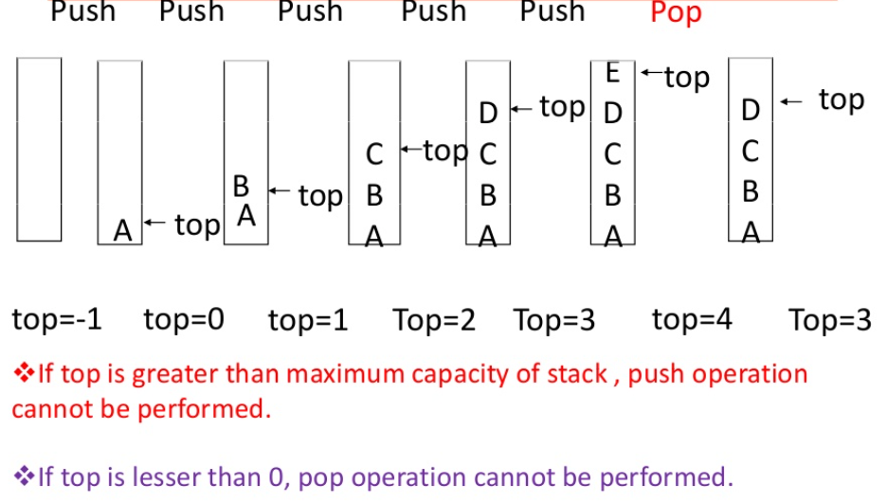
PUSH & POP – another view

Slide 11
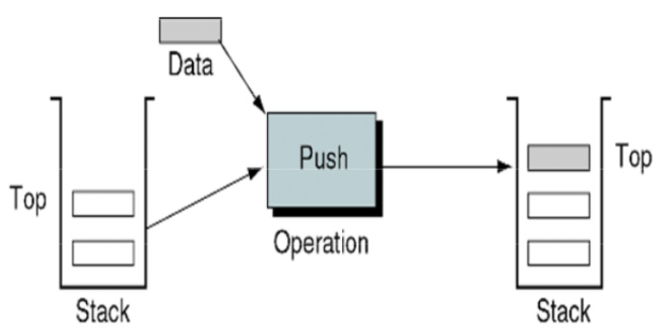
PUSH

Slide 12
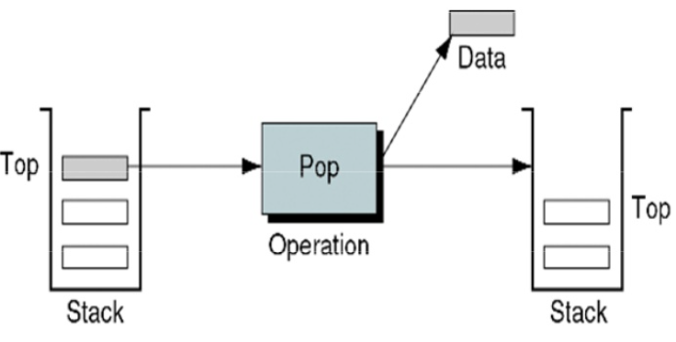
POP

Slide 13
Implementing a Stack
The Stack collection could be implemented in various ways; let’s examine how we can use an array

Slide 14
Stack Implementation Issues
What do we need to implement a stack?
A data structure (container) to hold the data elements
Something to indicate the top of the stack

Slide 15
Array Implementation of a Stack
Our container will be an array to hold the data elements
Data elements are kept contiguously at one end of the array
The top of the stack will be indicated by its position in the array (index)
Let’s assume that the bottom of the stack is at index 0
The top of the stack will be represented by an integer variable that is the index of the next available slot in the array

Slide 16
Array Implementation of a Stack
A Stack s with 4 elements
0
1
2
3
4
5
6
7
…
s
stack
4
top
After pushing an element
0
1
2
3
4
5
6
7
…
s
stack
5
top

Slide 17
After popping one element
0
1
2
3
4
5
6
7
…
stack
s
4
top
After popping a second element
0
1
2
3
4
5
6
7
…
stack
s
3
top

Slide 18
The ArrayStack Class
Attributes (instance variables):
private T[ ] stack; // the container for the data
private int top; // indicates the next open slot
There is also a private constant private final int DEFAULT_CAPACITY=100;

Slide 19
//-----------------------------------------------------------------
// Creates an empty stack using the default capacity.
//-----------------------------------------------------------------
public ArrayStack( )
{
top = 0;
stack = (T[ ]) (new Object[DEFAULT_CAPACITY]);
}
//-----------------------------------------------------------------
// Creates an empty stack using the specified capacity.
//-----------------------------------------------------------------
public ArrayStack (int initialCapacity)
{
top = 0;
stack = (T[ ]) (new Object[initialCapacity]);
}
ArrayStack constructors

Slide 20
Example of using Constructor to create a Stack of Numbers
What happens in memory when an ArrayStack object is created using the following statement?
ArrayStack<Integer> s =
new ArrayStack<Integer>(5);
top
Technically, the instance variables lie inside the stack object, but the array referenced by stack lies outside it
0
s
stack
?
?
?
?
?
0
1
2
3
4

Slide 21
Example: the same ArrayStack object after four items have been pushed on
top
4
56
17
s
stack
0
2
4
?
1
3
41
32

Slide 22
//-----------------------------------------------------------------
// Adds the specified element to the top of the stack,
// expanding the capacity of the stack array if necessary
//-----------------------------------------------------------------
public void push (T element)
{
if (top == stack.length)
expandCapacity( );
stack[top] = element;
top++;
}
The push( ) operation

Slide 23
Managing Capacity
An array has a particular number of cells when it is created (its capacity), so the array's capacity is also the stack's capacity
What happens when we want to push a new element onto a stack that is full, i.e. add it to an array that is at capacity?
The push method could throw an exception
It could return some kind of status indicator (e.g. a boolean value true or false, that indicates whether the push was successful or not)
It could automatically expand the capacity of the array

Slide 24
//-----------------------------------------------------------------
// Helper method to create a new array to store the
// contents of the stack, with twice the capacity
//-----------------------------------------------------------------
private void expandCapacity( )
{
T[ ] larger = (T[ ]) (new Object[stack.length*2]);
for (int index=0; index < stack.length; index++)
larger[index] = stack[index];
stack = larger;
}
The expandCapacity( ) helper method

Slide 25
//-----------------------------------------------------------------
// Removes the element at the top of the stack and returns a
// reference to it. Throws an EmptyCollectionException if the
// stack is empty.
//-----------------------------------------------------------------
public T pop( ) throws EmptyCollectionException
{
if (isEmpty( ))
throw new EmptyCollectionException(“Stack” );
top--;
T result = stack[top];
stack[top] = null;
return result;
}
The pop( ) operation

Slide 26
//-----------------------------------------------------------------
// Returns a string representation of this stack.
//-----------------------------------------------------------------
public String toString( )
{
String result = "";
for (int index=0; index < top; index++)
result = result + stack[index].toString( ) + "\n";
return result;
}
The toString( ) operation

Slide 27
//-----------------------------------------------------------------
// Returns the number of elements in the stack
//-----------------------------------------------------------------
public int size( )
{
return top;
}
//-----------------------------------------------------------------
// Returns true if the stack is empty and false otherwise
//-----------------------------------------------------------------
public boolean isEmpty( )
{
return (top == 0);
}
The size( ) operation
The isEmpty( ) operation

Slide 28
//-----------------------------------------------------------------
// Returns a reference to the element at the top of the stack.
// The element is not removed from the stack.
// Throws an EmptyCollectionException if the stack is empty.
//-----------------------------------------------------------------
public T peek( ) throws EmptyCollectionException
{
}
The peek( ) operation

Slide 29
STACK APPLICATIONS
Recursion handling
Evaluation of expression
Conversion of infix to postfix expression
Computation of postfix expression
Parenthesis handling
Backtracking
Conversion of decimal to other number system Maze tracer
Undo operations

Slide 30
RECURSION HANDLING
Without stack, recursion is difficult
Compiler automatically uses stack data structure while handling recursion.
All computer needs to remember for each active function call, values of arguments & local variables and the location of the next statement to be executed when control goes back.
Essentially what is happening when we call that method is that our current execution point is pushed onto the call stack and the runtime starts executing the code for the internal method call. When that method finally returns, we pop our place from the stack and continue executing.

Slide 31
Eg: int f(int n)
{ int k,r;
if(n==0) return 0; k=n*n;
r=f(n-1); Return k+r;
}
n k r
3
3
3 | 2
9 | 4
. | .
3 | 2 | 1
9 | 4 | 1
. | . | .
-
9
-
.
n k r
3 | 2 | 1
9 | 4 | 1
. | . | 0
3 | 2
9 | 4
. | 1
3
9
5
Ans: 14

Slide 32
PARENTHESIS CHECKING
Procedure check()
Declare a character stack S. Now traverse the expression.
If the current character is a starting bracket then push it to stack.
If the current character is a closing bracket then pop from
stack and if the popped character is the matching starting bracket
then fine else parenthesis are not balanced.
After complete traversal, if there is some starting bracket left in stack
then “not balanced”
End procedure

Slide 33
Eg: [a+(b*c)+{(d-e)}]
[
Push [
[ (
Push (
[
) and ( matches, Pop (
[ {
Push {
[ { (
Push (
[ {
matches, pop (
[
Matches, pop {
Matches, pop [
Thus, parenthesis match here

Slide 34
UNDO OPERATION
An undo operation is a method for reverting a change to an object, along with the arguments needed to revert the change.
Undo operations are typically collected in undo groups, which represent whole revertible actions, and are stored on a stack.
To undo a single operation, it must still be packaged in a group.
Undo groups are stored on a stack, with the oldest groups at the bottom and the newest at the top.
The undo stack is unlimited by default, but you can restrict it.
When the stack exceeds the maximum, the oldest undo groups are dropped from the bottom.

Slide 35
UNDO OPERATION
Initially, both stacks are empty. Recording undo operations adds to the undo stack, but the redo stack remains empty until undo is performed.
Performing undo causes the reverting operations in the latest group to be applied to their objects.
Consecutive undos add to the redo stack. Subsequent redo operations pull the operations off the redo stack, apply them to the objects, and push them back onto the undo stack.
The redo stack’s contents last as long as undo and redo are performed successively. However, because applying a new change to an object
invalidates the previous changes, as soon as a new undo operation is registered, any existing redo stack is cleared.

